Slide 1
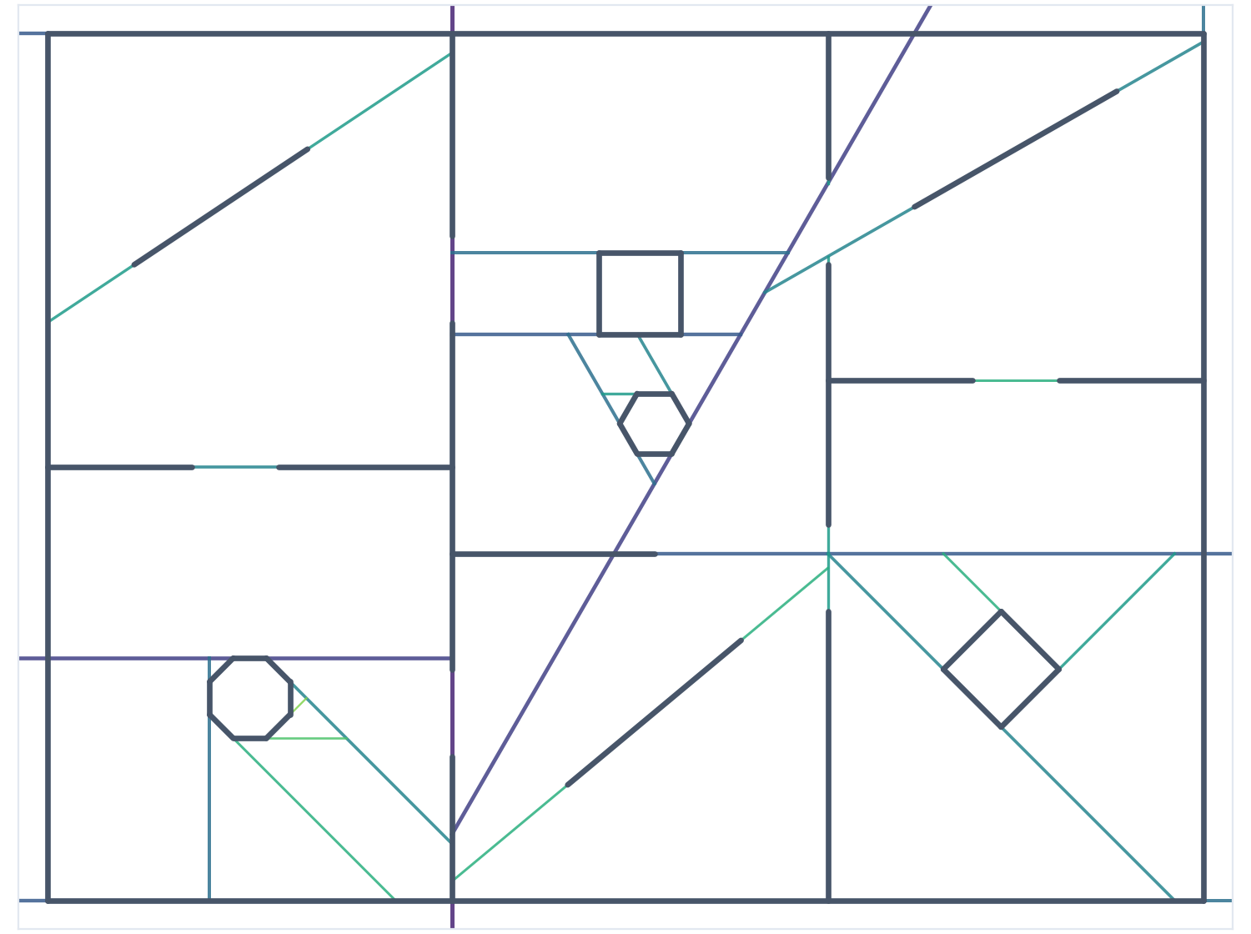
MINI PROJECT | BSP TREES
Real-Time Visibility Management in Virtual Environments
Using Binary Space Partitioning for spatial partitioning and visibility ordering
Sainag S
Reg. No. 2411021061329
Notes:
Introduce the topic: how a 3D engine decides what to draw, and how BSP trees answer that. The prototype is a working Python model.

Slide 2
Drawing everything every frame does not scale
13x
42x
2.4
overdraw with naive back-to-front drawing in a 1,935-wall level
fewer walls processed per frame with a BSP front-to-back walk
walls actually visible on average, out of 1,935
Visibility problem: decide which surfaces can be seen from the camera, and draw them in a correct order, within a ~16 ms frame budget.
Notes:
Numbers are measured by the Python prototype on random mazes (see Results slide). Overdraw = column writes per screen column.

Slide 3
Spatial partitioning: split space with the walls themselves
1
Pick a wall as the splitter
Its line divides the plane into a front half and a back half.
2
Sort the other walls
Front list, back list. Walls crossing the line are split in two.
3
Recurse on both halves
Each node is a convex region; leaves are single-wall cells.
Our test level: 40 walls became 46 pieces (6 splits), built in 2.1 ms.
Notes:
Lines are coloured by tree depth: dark purple near the root, green deeper down. Each line is clipped to the convex cell it divides.

Slide 4
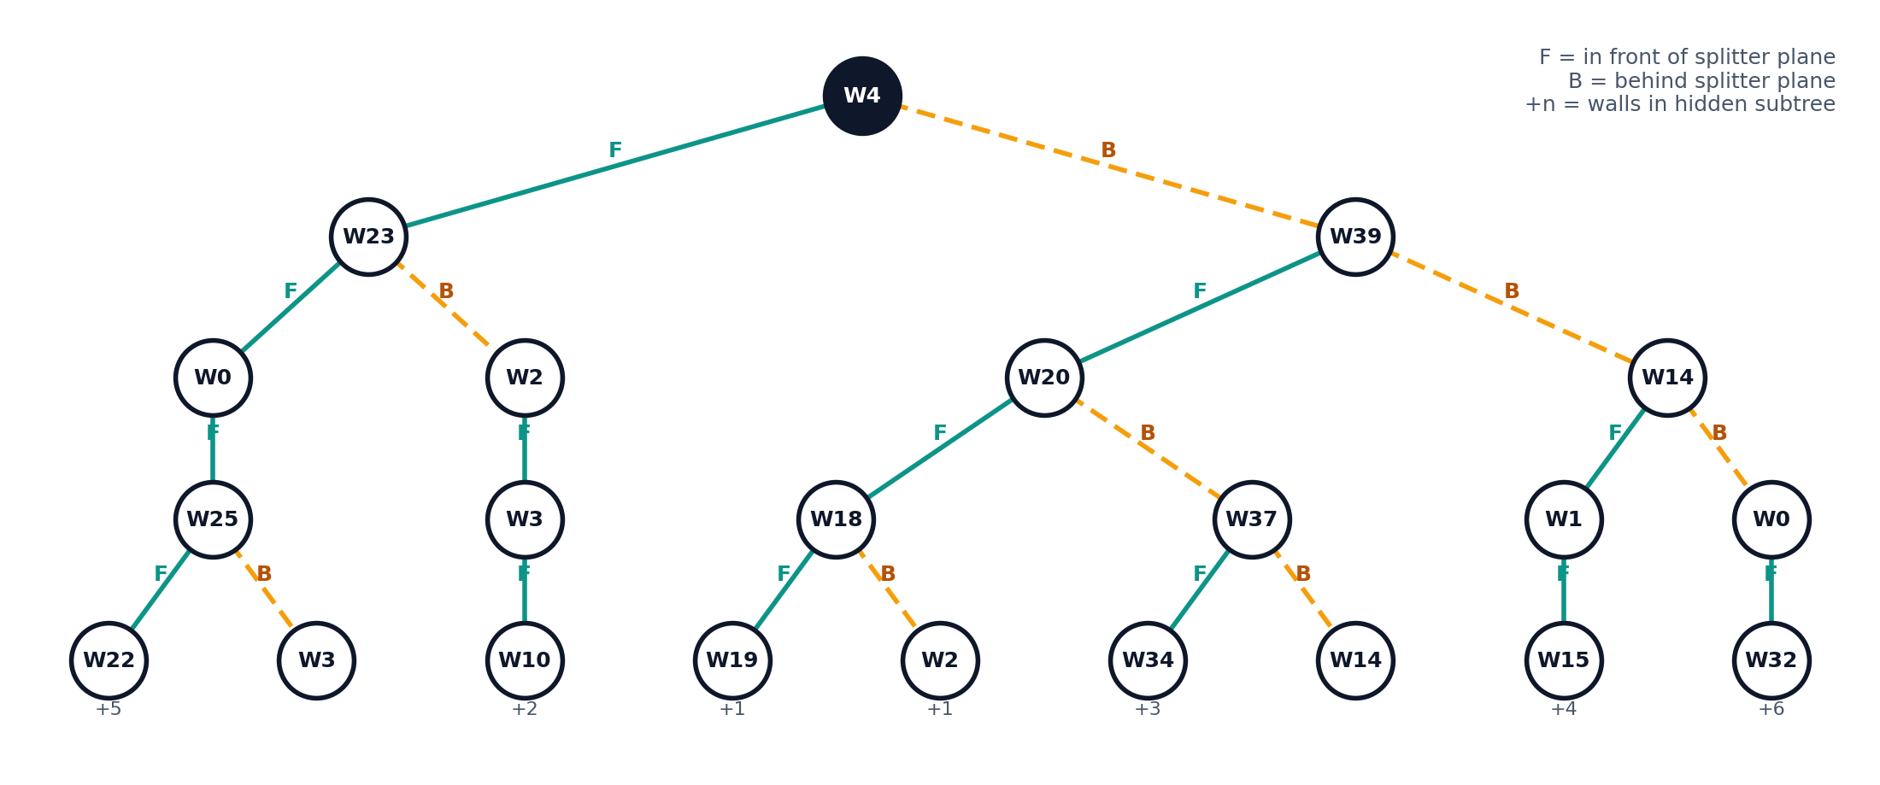
The result is a binary tree of splitting planes
42 nodes, depth 10. Splitter choice minimises splits and keeps front/back balanced. The tree is built once, offline, and reused for every camera position.

Slide 5
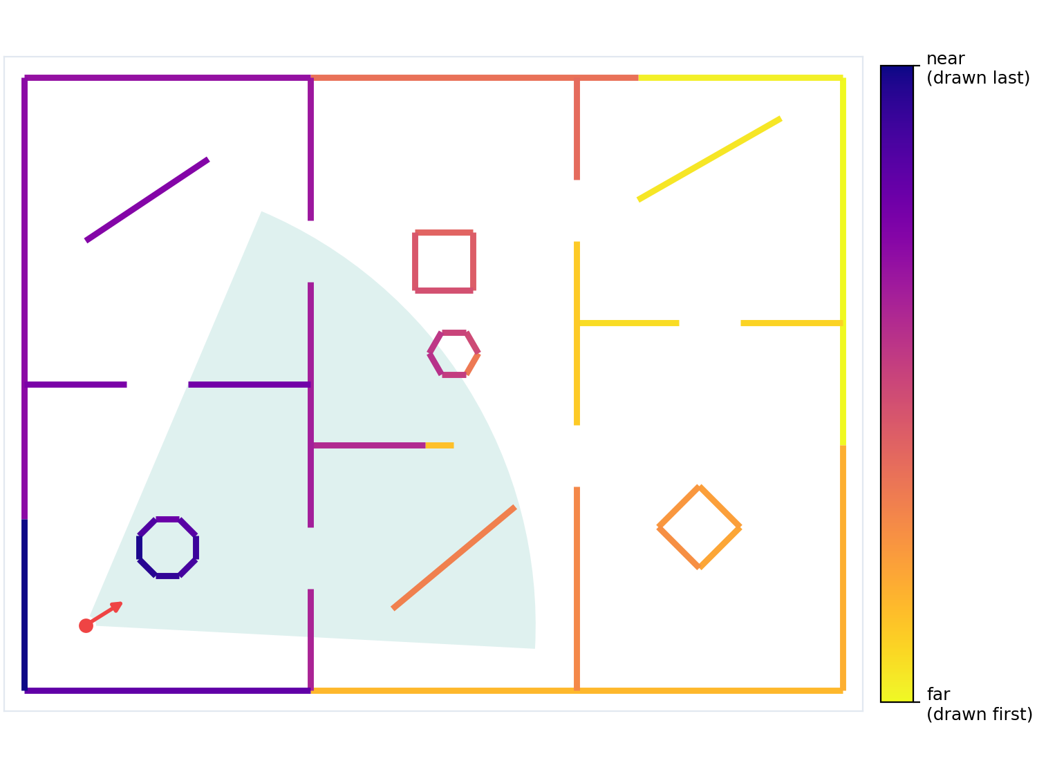
Visibility ordering from one tree walk
walk(node, eye):
if eye in FRONT of node.plane:
walk(node.back, eye)
draw(node.walls)
walk(node.front, eye)
else: mirror image
Swap the two recursive calls and the same walk gives front-to-back order. No sorting, no depth buffer, correct from any viewpoint.
Notes:
Colours show the back-to-front rank for the camera in the lower left: yellow is drawn first, dark blue last.

Slide 6
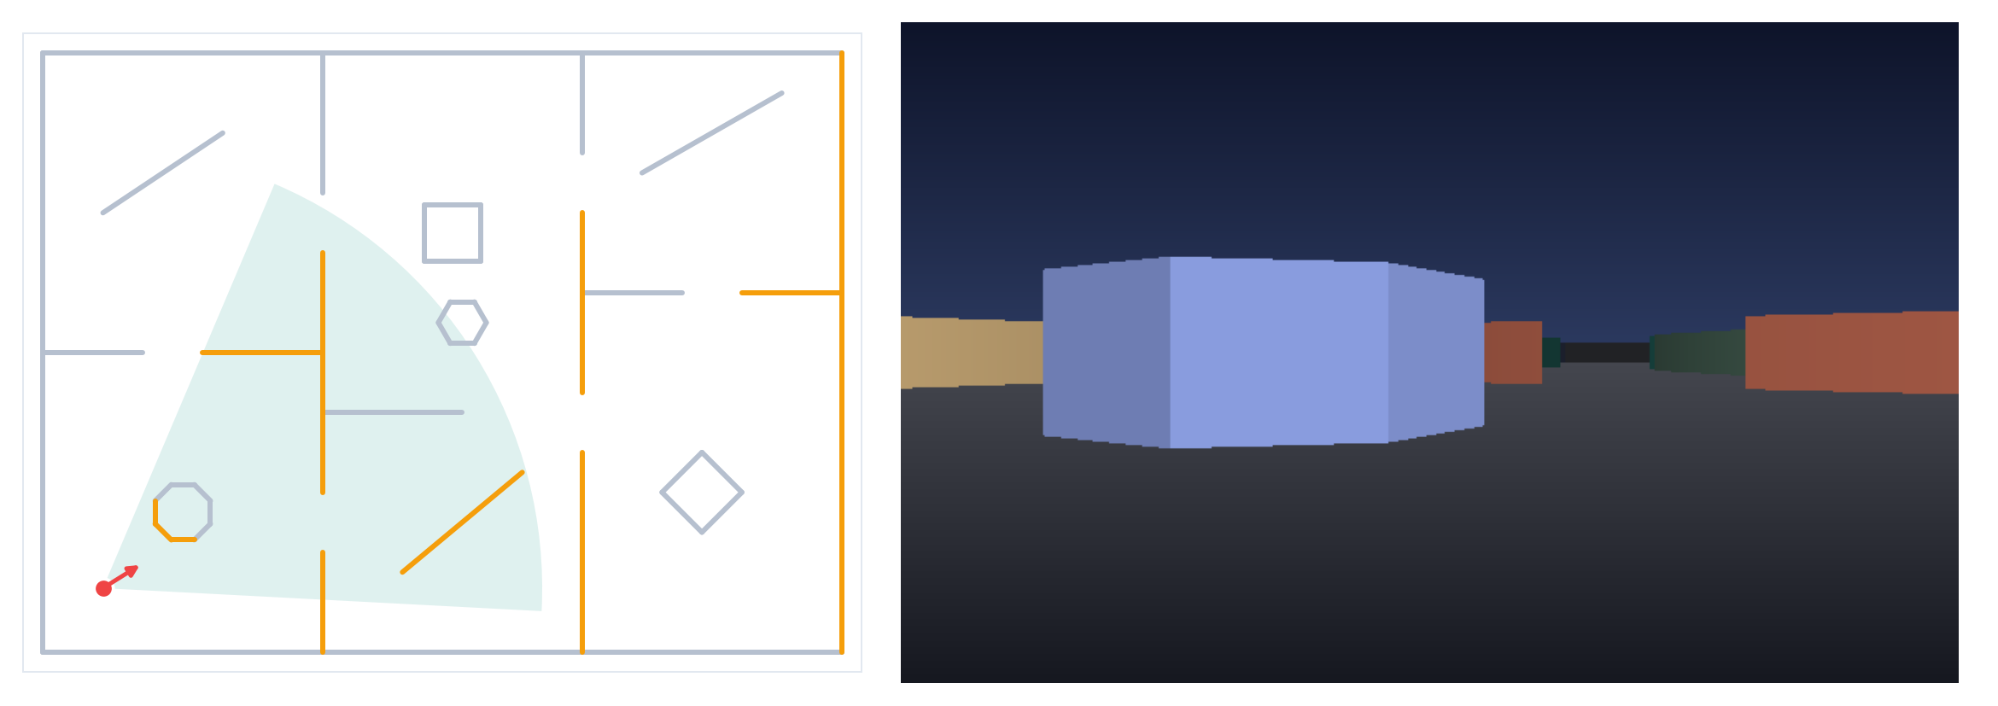
Visibility management: draw only what can be seen
Frustum culling
Coverage buffer
Early exit
A subtree whose bounding box is outside the view cone is skipped.
Walls arrive nearest-first and fill only unclaimed screen columns.
Traversal stops once every column is covered.
Notes:
In this view 11 of 40 walls are visible (amber). Overdraw: 4.5x for the painter's algorithm versus 1.0x for front-to-back.

Slide 7
Results: cost follows what is visible, not level size
At 1,935 walls: 5.3 ms per frame without structure vs 0.41 ms with BSP (Python, visibility pass only, mean of 20 random camera poses in random mazes).
Notes:
Mazes are axis-aligned, so no wall splitting occurs in the benchmark; the building level exercises splitting with diagonal walls.

Slide 8
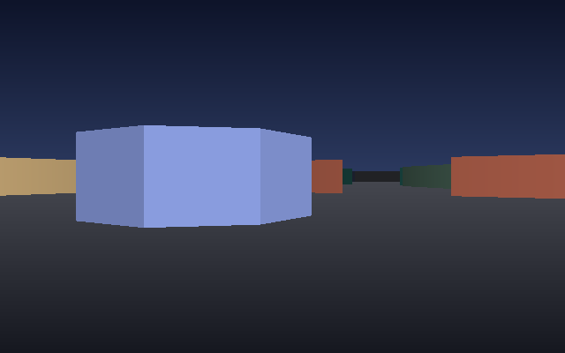
The prototype is checked against a reference renderer
Length preserved
Pieces from every split sum to the original wall length.
Plane invariant
Every piece lies on the correct side of all ancestor planes.
Image match
Software-rendered first-person view from the BSP front-to-back pass.
99.8% of pixels equal a z-buffer render over 40 random poses, for both traversal orders.
Run: python bsp_visibility.py (interactive explorer)

Slide 9
Conclusion
Partition once
Order for free
Scale with visibility
An auto-partitioned BSP tree turns a wall list into a spatial index.
One tree walk gives exact visibility order from any viewpoint.
Work per frame stayed near 46 walls as the level grew to 1,935.
Limits and next steps: static geometry only; moving objects need separate handling. Next: 3D polygon BSP, portals / PVS, and a GPU renderer.

